Slide 1
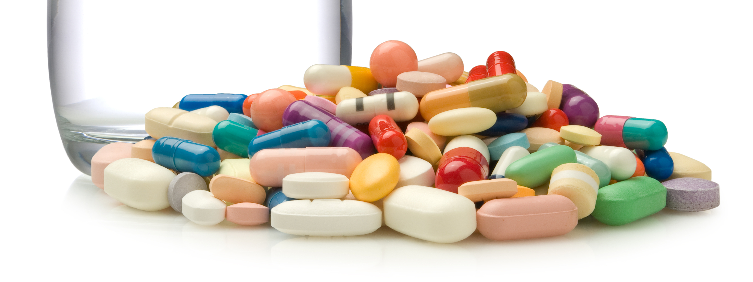
Financial Economic Analysis for Investment in Medicinal Drugs
Group 9
Harsh Shah
Sagar Kamra
Dong Li
Dhruvan Patel

Slide 2
Contents
Introduction
Assumptions
Scope
Project Alternatives
Sources of Capital
Project Funding
Depreciation
Before Tax Cash Flow/After Tax Cash Flow/MARR
Present Worth Comparison with Different MARR
AHP Analysis
Risk Analysis
Conclusion

Slide 3
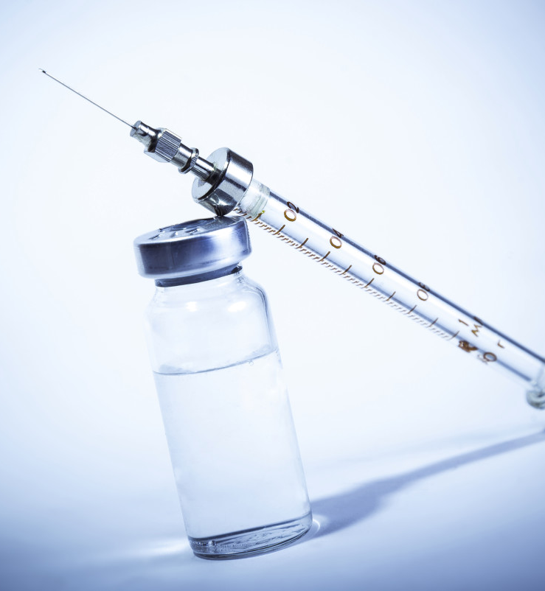
Introduction
World is developing on its fastest pace to get revolutionized and make a difference on a planet with different innovation every day in each business sectors.
Hence we are analyzing three alternatives for investing in Healthcare Industry specific to Medicinal Drugs
It is predicted that the global Healthcare Industry will register a stable growth rate during 2018, and it will cross the $1.85 trillion mark in terms of manufactures’ revenues.

Slide 4
Assumptions
Project Planning Horizon: 10 years (Standard for all 3 ALT.)
Payback Methods:
Plan 1: Pay interest each year and pay of the principal at the end
Plan 3: Make equal end of period payments over the loan period
Cost & Sales of Items:
Assumed the value of cost of the items(Lab Equipment and Infrastructure)
Assumed the sales of items (Capsules/Vaccine)
Assumed capital structure of our project
Economic Analysis Factor:
MARR: 6%
Tax Rate: 40.00%
Interest Rate: 5.80%

Slide 5
Scope
Considered depreciation of assets
Calculated before tax cash flow and after tax cash flow analysis after applying tax rate of 40.00% on taxable income.
Performed Sensitivity Risk Analysis
Performed
Present Worth
Future Worth
Annual Worth
IRR
ERR
Pay Back Period
AHP Method
Compared Present Worth of all 3 alternatives with a MARR values to identify the preferred Alternative

Slide 6
Project Alternatives
They have the maximum number of sales respect to units.
As mostly being available without prescriptions.
The researchers found that for every 1,000 people, antibiotic consumption rates increased from 11.3 doses per day in 2000 to 15.7 does per day in 2015. The use of the most common type of antibiotics increased by 36% and is still increasing.
Cancer medicines have a higher market value compared to other drugs.
It is predicted that estimates that there will be 1,735,350 new cancer cases

Slide 7
Cost Involved in the Project
 | Alternative 1 |  | Alternative 2 |  | Alternative 3
Factors | Cancer Medicine |  | Analgesic (Pain Killer) |  | Anti-Biotic
 | One-Shot Investment | Yearly Investment | One-Shot Investment | Yearly Investment | One-Shot Investment | Yearly Investment
Research Cost |  | $1,800,000.00 |  | $2,300,000.00 |  | $1,900,000.00
Equipment Cost | $2,300,000.00 |  | $1,750,000.00 |  | $1,100,000.00
Lab Infrastructure Cost | $1,250,000.00 |  | $980,000.00 |  | $1,000,000.00
Prototype Development |  | $13,600,000.00 |  | $8,900,000.00 |  | $6,500,000.00
Market Testing | $480,000.00 |  | $600,000.00 |  | $450,000.00
FDA Approval Cost | $500,000.00 |  | $450,000.00 |  | $400,000.00
Product Development Cost | $5,200,000.00 |  | $3,900,000.00 |  | $4,100,000.00
Product Marketing | $835,000.00 | $60,000.00 | $650,000.00 | $65,000.00 | $1,000,000.00 | $85,000.00
Product Launch Cost | $102,000.00 |  | $95,000.00 |  | $95,000.00
Insurance |  | $105,000.00 |  | $98,000.00 |  | $79,000.00
TOTAL COST | $10,667,000.00 | $15,565,000.00 | $8,425,000.00 | $11,363,000.00 | $8,145,000.00 | $8,564,000.00
 | Total | $26,232,000.00 | Total | $19,788,000.00 | Total | $16,709,000.00

Slide 8
Project Funding
LOAN
Loan Amount | $17,050,800.00
N | 10 Yrs
Interest Rate | 5.80%
Effective Interest Rate | 5.94%
Tax Rate | 40%
Kl | 3.56%
STOCKS
Stock Value | $2,623,200.00
N | 10 Yrs
Tax rate | 40%
Annual Dividend | $35,000.00
Brokerage Fee per share | $180.00
Eps | 13.34%
Loan
Stocks
BONDS
Bond Amount | $6,558,000.00
N | 10 Yrs
Bond Price | 2000
Bond Selling Price | $7,738,440.00
Interest Rate | 12%
Interest per year | $786,960.00
Ib | 12.98%
Tax rate | 40%
Kb | 7.79%
Bonds

Slide 9
Depreciation
Depreciation Items:
Lab Equipment's
Lab Infrastructure
Depreciable Methods:
Straight Line Depreciation (SLN)
It considers the cost of material, salvage value and life
We have used SLN depreciation for “Lab Infrastructure”.
Declining Balance (DB) Depreciation
It considers Cost of material, Salvage value, Life and Period
We have used DB depreciation for “Lab equipment”.

Slide 10
Depreciable Properties
ALTERNATIVE 1
TYPE | PROPERTY NAME | COST | SALVAGE VALUE
Equipment | Lab Equipment | $2,300,000.00 | $700,000
TOTAL |  | $2,300,000 | $700,000
TYPE | PROPERTY NAME | COST | SALVAGE VALUE
Infrastructure | Lab Infrastructure | $1,250,000.00 | $0
TOTAL |  | $1,250,000 | $0
ALTERNATIVE 2
TYPE | PROPERTY NAME | COST | SALVAGE VALUE
Equipment | Lab Equipment | $1,750,000.00 | $670,000
TOTAL |  | $1,750,000 | $670,000
TYPE | PROPERTY NAME | COST | SALVAGE VALUE
Infrastructure | Lab Infrastructure | $980,000.00 | $0
TOTAL |  | $980,000 | $0
ALTERNATIVE 3
TYPE | PROPERTY NAME | COST | SALVAGE VALUE
Equipment | Lab Equipment | $1,100,000.00 | $655,000
TOTAL |  | $1,100,000 | $655,000
TYPE | PROPERTY NAME | COST | SALVAGE VALUE
Infrastructure | Lab Infrastructure | $1,000,000.00 | $0
TOTAL |  | $1,000,000 | $0

Slide 11

Different Analysis for each Alternative
Net Cash Flow Before Tax
Net Cash Flow After Tax
Regression Model
Linear/Logarithmic/Moving-Average Regressions to forecast the future revenues for the next 10 years
Pay Back Method Analysis
Present Worth V/S MARR

Slide 12
Present Worth Comparison with Different MARR

Slide 13
AHP Analysis
Research Effort
Factor 2
Present Worth
Factor 3
Probability of Sales
Factor 4
Target Population
Factor 1

Slide 14
AHP Analysis Report of all 3 Alternatives

Slide 15
Risk Analysis
Fixed Input
MARR
Uncertain Inputs
Investment Cost, Revenue per year, Yearly O&M Cost, Annual Savings Growth Rate
Distribution to uncertain inputs
Triangular, Normal
Outputs
Present Worth, Future Worth, IRR

Slide 16
Present Worth Risk Analysis
Future Worth Risk Analysis
IRR Worth Risk Analysis

Slide 17
Conclusion
After applying after tax analysis by depreciating the assets and applying tax rate of 40.00% on taxable income.
Economic analysis such as Present Worth, Future Worth, Annual Worth, IRR, ERR, Pay Back Period and AHP Method were also performed.
After all the above evaluations, Alternative 3 (i.e. Anti Biotics is considered as the Best Alternative amongst the 3 and is preferred. It has a Present Worth of $16,299,158.44 and a Future Worth of $29,189,310.34
Factors | Alternative 1 | Alternative 2 | Alternative 3
Present Worth | ($13,836,835.31) | $13,486,381.53 | $16,299,158.44
Future Worth | ($24,779,664.64) | $24,152,055.30 | $29,189,310.34
Annual Worth | ($1,879,982.56) | $1,832,367.12 | $2,214,533.38
IRR | -5.52% | 17.06% | 20.19%
ERR | -3.60% | 13.01% | 14.42%
Pay Back Period | 11.42 Yrs | 6.35 Yrs | 5.64 Yrs
AHP % Weight | 8.16% | 30.11% | 70.55%

